Slide 1

A MAJOR PROJECT FINAL DEFENSE
ON “FACE MASK DETECTION SYSTEM”
Supervised By: Er.Bipin KC
Submitted by:
Mahesh Mahato [25785]
Prasanna Khati [25797]
Simon D Bista [25825]
Utsav Paudel [25838]
Submitted to: Department of Computer and Electronics
April 18, 2022

Slide 2

Introduction
Computer vision based project to detect whether a person is wearing mask or not.
Our application can help differentiate the masked person from a unmasked person
We are using Neural network for this purpose.
2

Slide 3
Problem Statement
Recognizing a face and face mask properly.
Avoiding faulty detections of objects.
Making computer learn to see objects the way human see through their visual cortex
3

Slide 4
Objectives
Detect a mask being put on face.
4

Slide 5
Application
Detect People wearing no mask
Marketing and scientific research.
5

Slide 6
Features
Detect face.
Detect mask.
Detect whether mask is properly worn or not.
6

Slide 7
Literature review
The basis for the face mask detection is from the research paper by:
S. S. A. S. Liu, “Covid-19 face mask detection in a crowd using multi-model based on yolov3 and hand-crafted features,” Multimodal Image Exploitation and Learning, 2021.The presented framework is based on new artificial intelligence tools that use hand-crafted and deep learning (YOLOv3 and CNNs) features and SVM classifiers. And used different datasets and has accuracy of 0.987.
M. W. A. A. Das and R. Basak, “Covid-19 face mask detection using tensorflow, keras and opencv,” 2020.proposed a facemask detection system using Convolutional Neural network which achieved 94.58%accuracy rate.
J. D. Amit Chavda, “Multi-stage cnn architecture for face mask detection,” iPing Data Labs LLP,Mumbai, 2020, 2020.proposed a detection system using CNN model which can achieved 99.49% accuracy rate in facemask detection
7

Slide 8
“Multi-task Cascaded Convolutional Networks(MTCNN)” for face detection and Facial Landmark Alignment”(R.Gradilla, (2020)).Proposed a face detection and alignment system using MTCNN.
Convolutional Neural Network(CNN) is based on neural patterns followed by mammals to recognize objects.
The paper shows advantage of CNN over all other techniques to recognize
face with mask with proper orientation or face without mask.

Slide 9
Convolution Neural Network
An Artificial Neural Network used in image recognition and processing which has multiple hidden layers that help in extracting information from an image which makes it easier for facial classification.
Convolution Layer
It transforms input image in order to extract feature map which points out features from the input layer using kernels.
ReLu Layer
Introduces non-linearity and performs an element-wise operation and sets all negative pixels to 0

Slide 10
Pooling
It is a down-sampling operation that reduces the dimensionality of the feature map
Flattening
It converts all the resultant 2-Dimensional arrays from pooled feature maps into single long continuous linear vector
Fully Connected Layer
It is a simple densely connected neural network layers where it takes input from final pooling and applies softmax for output prediction

Slide 11
Methodology
Acquire a large dataset of faces with and without mask.
Design a neural network and train it.
11

Slide 12
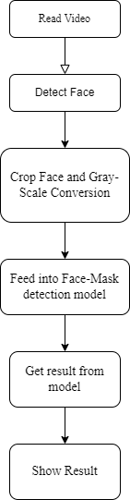
Flowchart of the working Methodology

Slide 13
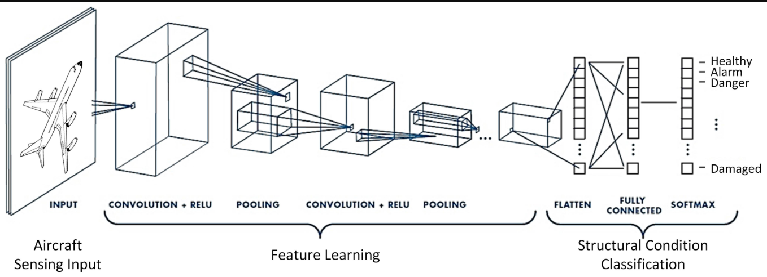
CNN Architecture for Mask Detection
13

Slide 14
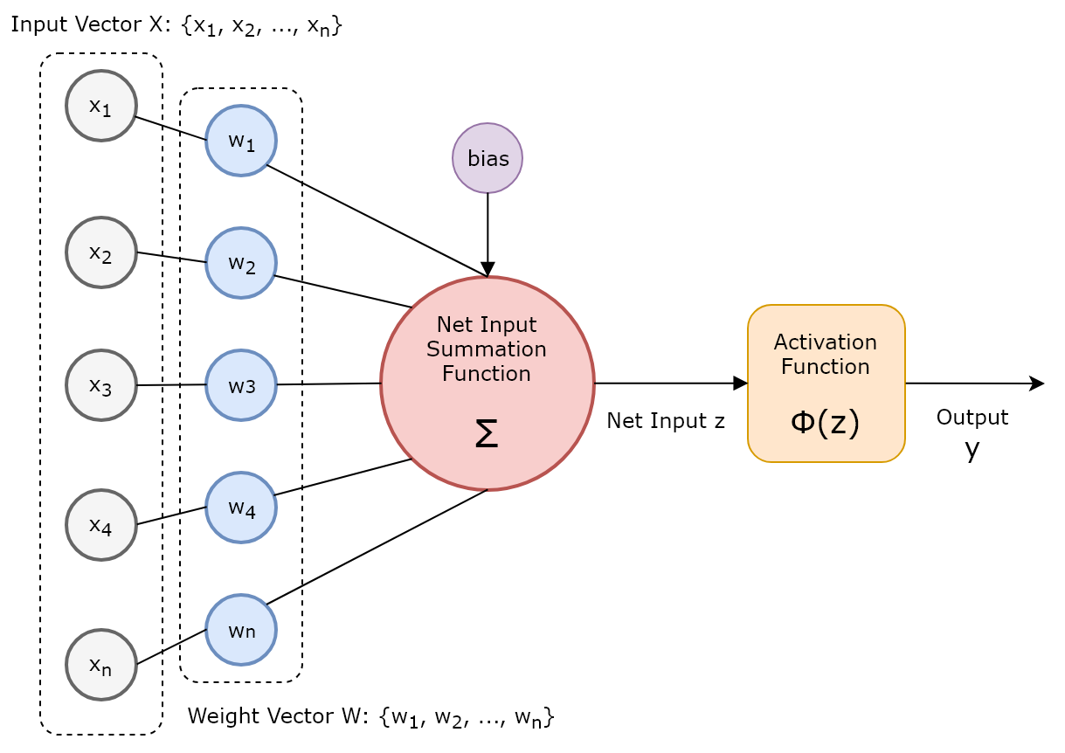
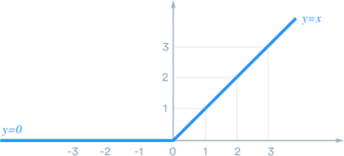
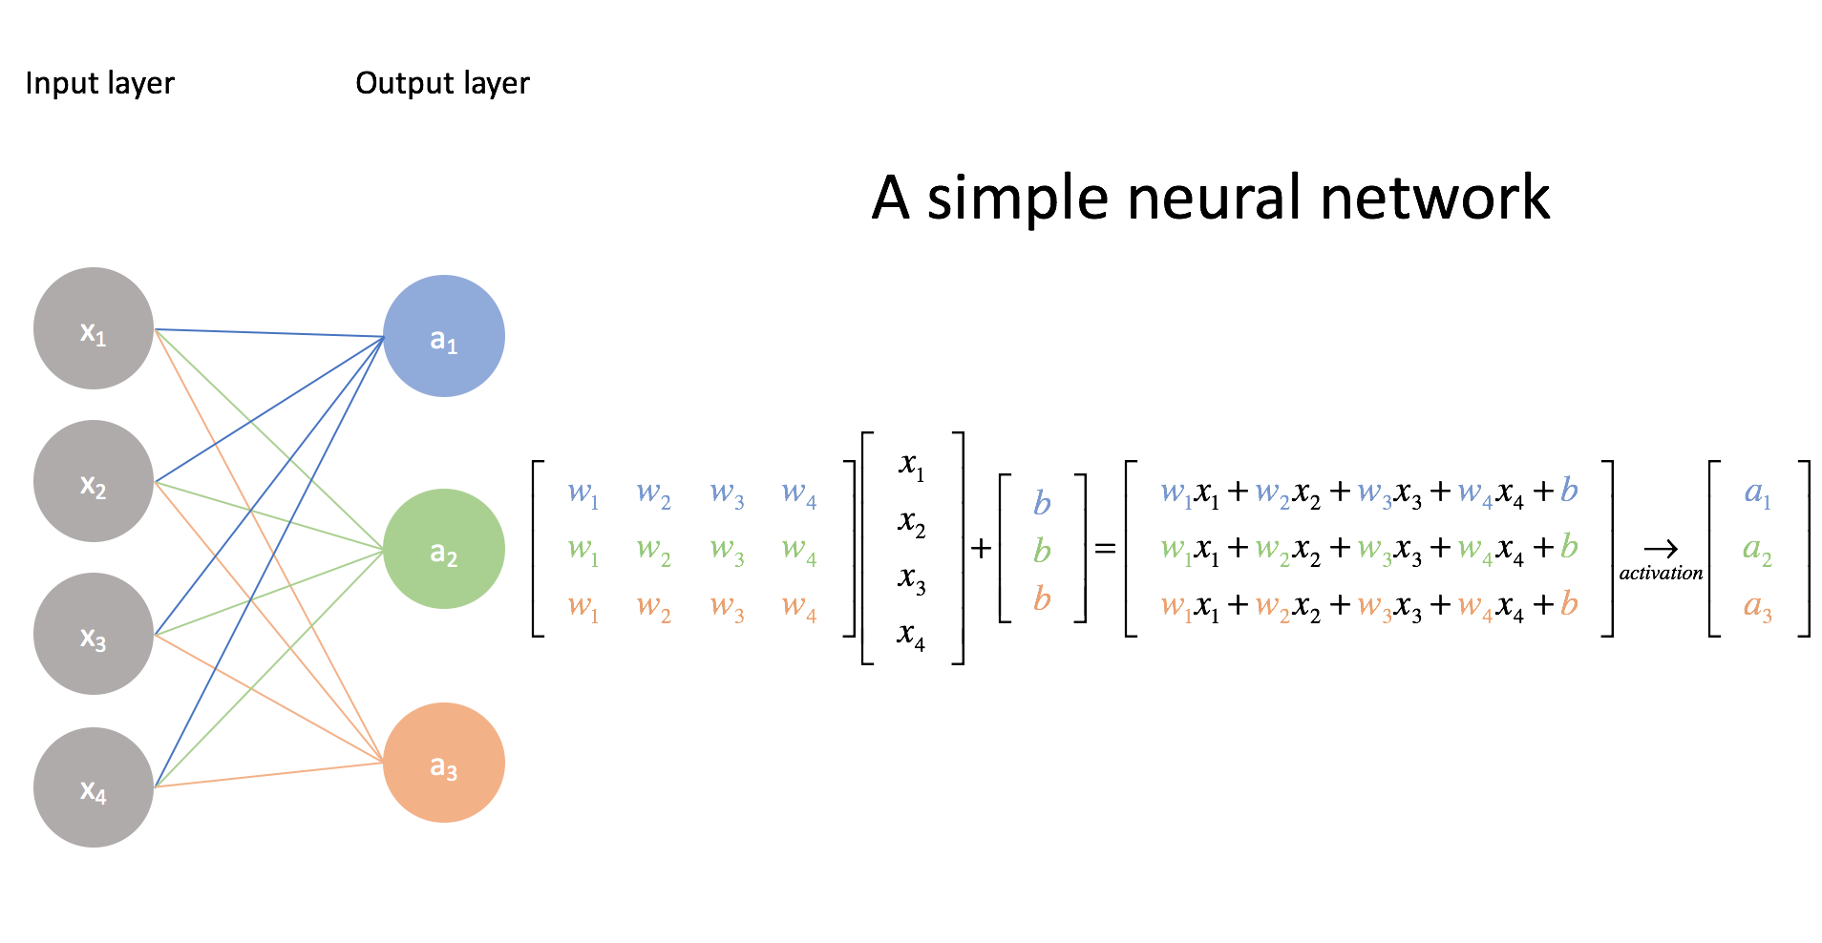
ReLU
Artificial Neuron
14

Slide 15
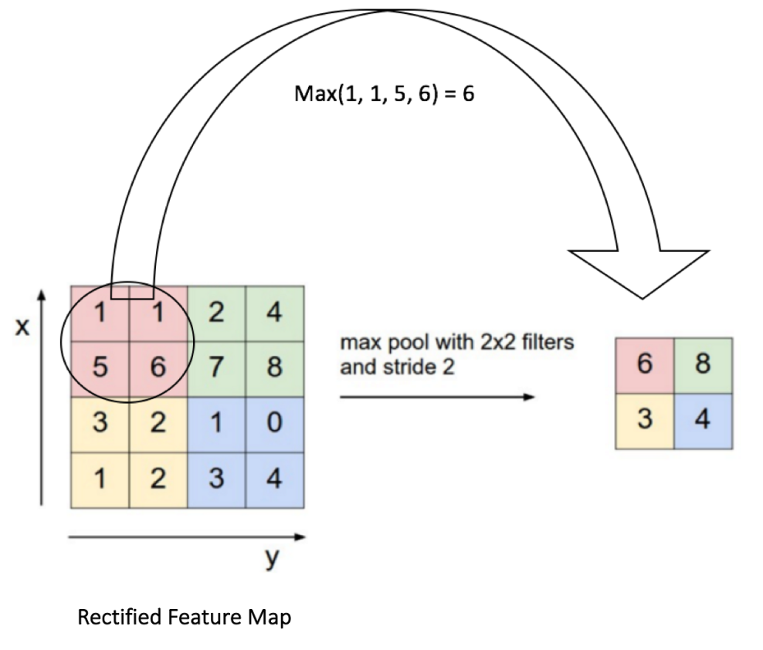
Convolutional
Max Pooling
15

Slide 16
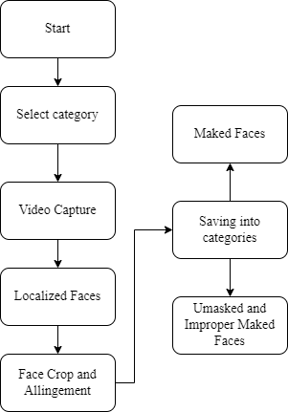
Data Extractor and Dataset Creator

Slide 17
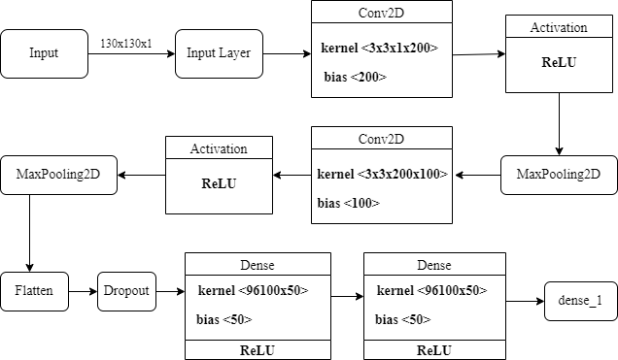
Architecture Of Our Model

Slide 18
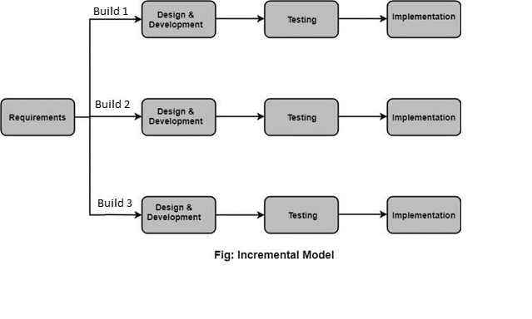
Software Model
Various Phases of Incremental Model
Requirement Gathering
Design & Development
Testing
Implementation
18

Slide 19
TRAINING OF FACE MASK DETECTION MODEL
Training of the model is done with two classes: Masked and Unmasked (Improper Masked as well).
Our data extractor can take local datas and can be trained with those datas.
Those image datas were processed form MTCNN and trained into model for masked and unmasked faces.

Slide 20
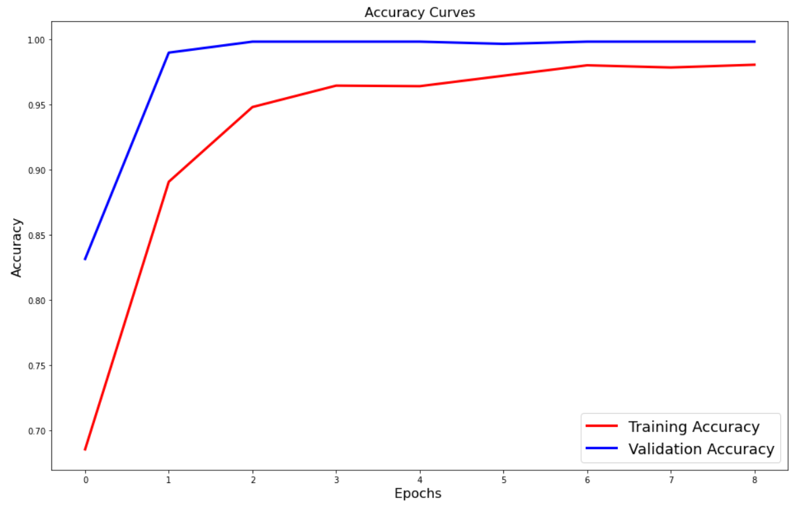
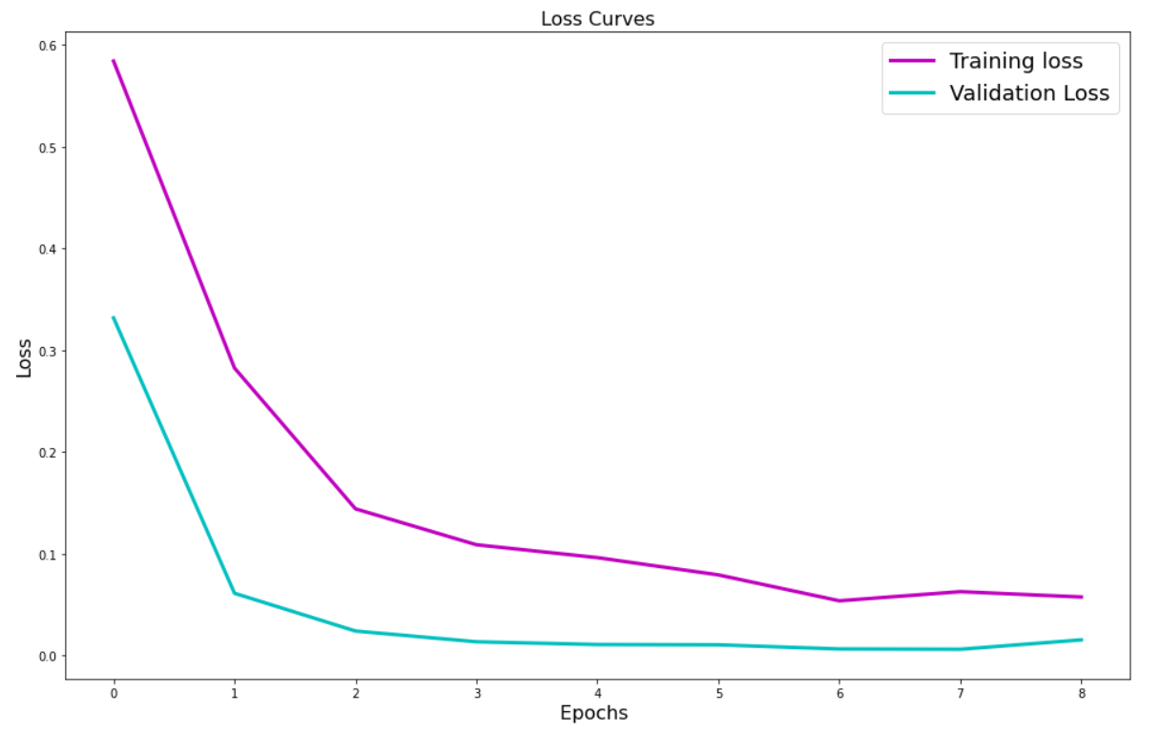
Figure: Accuracy of Mask-Detection Model
Figure: Loss of Mask-detection Model
Training accuracy:0.9906
Validation accuracy:0.9983
(at 8 epoch)
Training loss:0.0575
Validation accuracy:0.0154
(at 8 epoch)

Slide 21
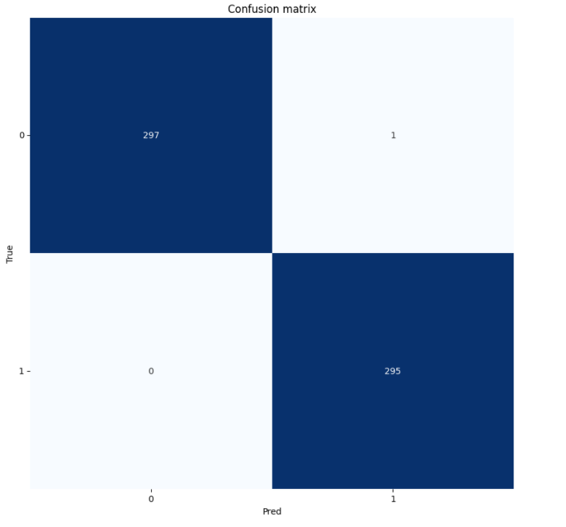
Figure: Confusion matrix of testing
The training correctly predicted 297 unmasked faces and 295 masked faces
and shows 1 false positive for unmasked faces.

Slide 22
RESULT & DISCUSSION
After the project completion we ran the face mask detection model.
We then generated the accuracy,loss and confusion matrix of model for the visualization of the working.
Our output is shown in console with clean and simple prompt.

Slide 23
CONCLUSION
Our System can perform face mask detection in a single integrated module.
It can distinguish masked and unmasked face.

Slide 24
Future Enhancement
We can add more amount of images in our datasets for better model training and testing.
We can also add new classes ie.(improper mask detection).
We can make it work for more low lightning condition by training our model for enough time.

Slide 25
Convolution Neural Network
An Artificial Neural Network used in image recognition and processing which has multiple hidden layers that help in extracting information from an image which makes it easier for facial classification.
Convolution Layer
It transforms input image in order to extract feature map which points out features from the input layer using kernels.
ReLu Layer
Introduces non-linearity and performs an element-wise operation and sets all negative pixels to 0

Slide 26
References
S. B. A. D. Amit Chavda, Jason Dsouza, “Multi-stage cnn architecture for face mask detection,” iPing Data Labs LLP, Mumbai, 2020.
M. M. B. M. A. J. M. S. I. F.M. Javed Mehedi Shamrat, Sovon Chakraborty and R. Ranjan, “Face mask detection using convolutional neural network (cnn) to reduce the spread of covid-19,” 5th International Conference on Trends in Electronics and Informatics (ICOEI 2021), 2021.
A. Das, M. Wasif Ansari, and R. Basak, “Covid-19 face mask detection using tensorflow, keras and opencv,” 2020 IEEE 17th India Council International Conference (INDICON), pp. 1–5, 2020.
S. Saravanan, K. Shanmugasundaram, and S. Ramasamy, “Farec cnn based efficient face recognition technique using dlib,” 2016 International Conference on Advanced Communication Control and Computing Technologies (ICACCCT), pp. 192–195, 2016.
A. M. R. A. P. K. J. H. Preeti Nagrath, Rachna Jain, “A real time dnn-based face mask detection system using single shot multibox detector and mobilenetv2,” Sustainable Cities and Society, vol. 66, 2021.
26

Slide 27
THANK YOU !

Slide 28
Adam Optimizer
It is a replacement optimization algorithm for stochastic gradient descent, which adds momentum in stochastic gradient descent.
Softmax
It is the activation function used in the output layer of neural network models that predict the a multinomial probability distribution to test the reliability of model using the loss function.
Binary Cross entropy loss function
It compares each of the predicted probabilities to actual class output which can be either 0 or 1 which penializes more when there is huge difference between ground truth and predicted values.

Slide 29
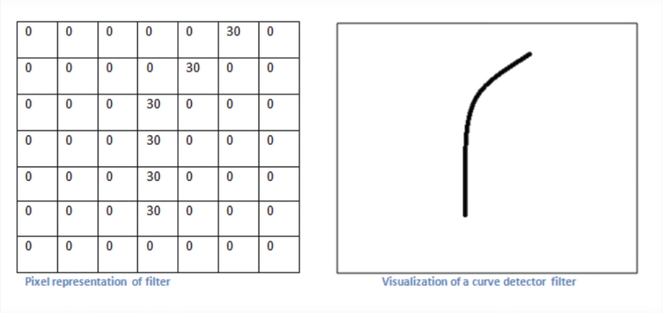
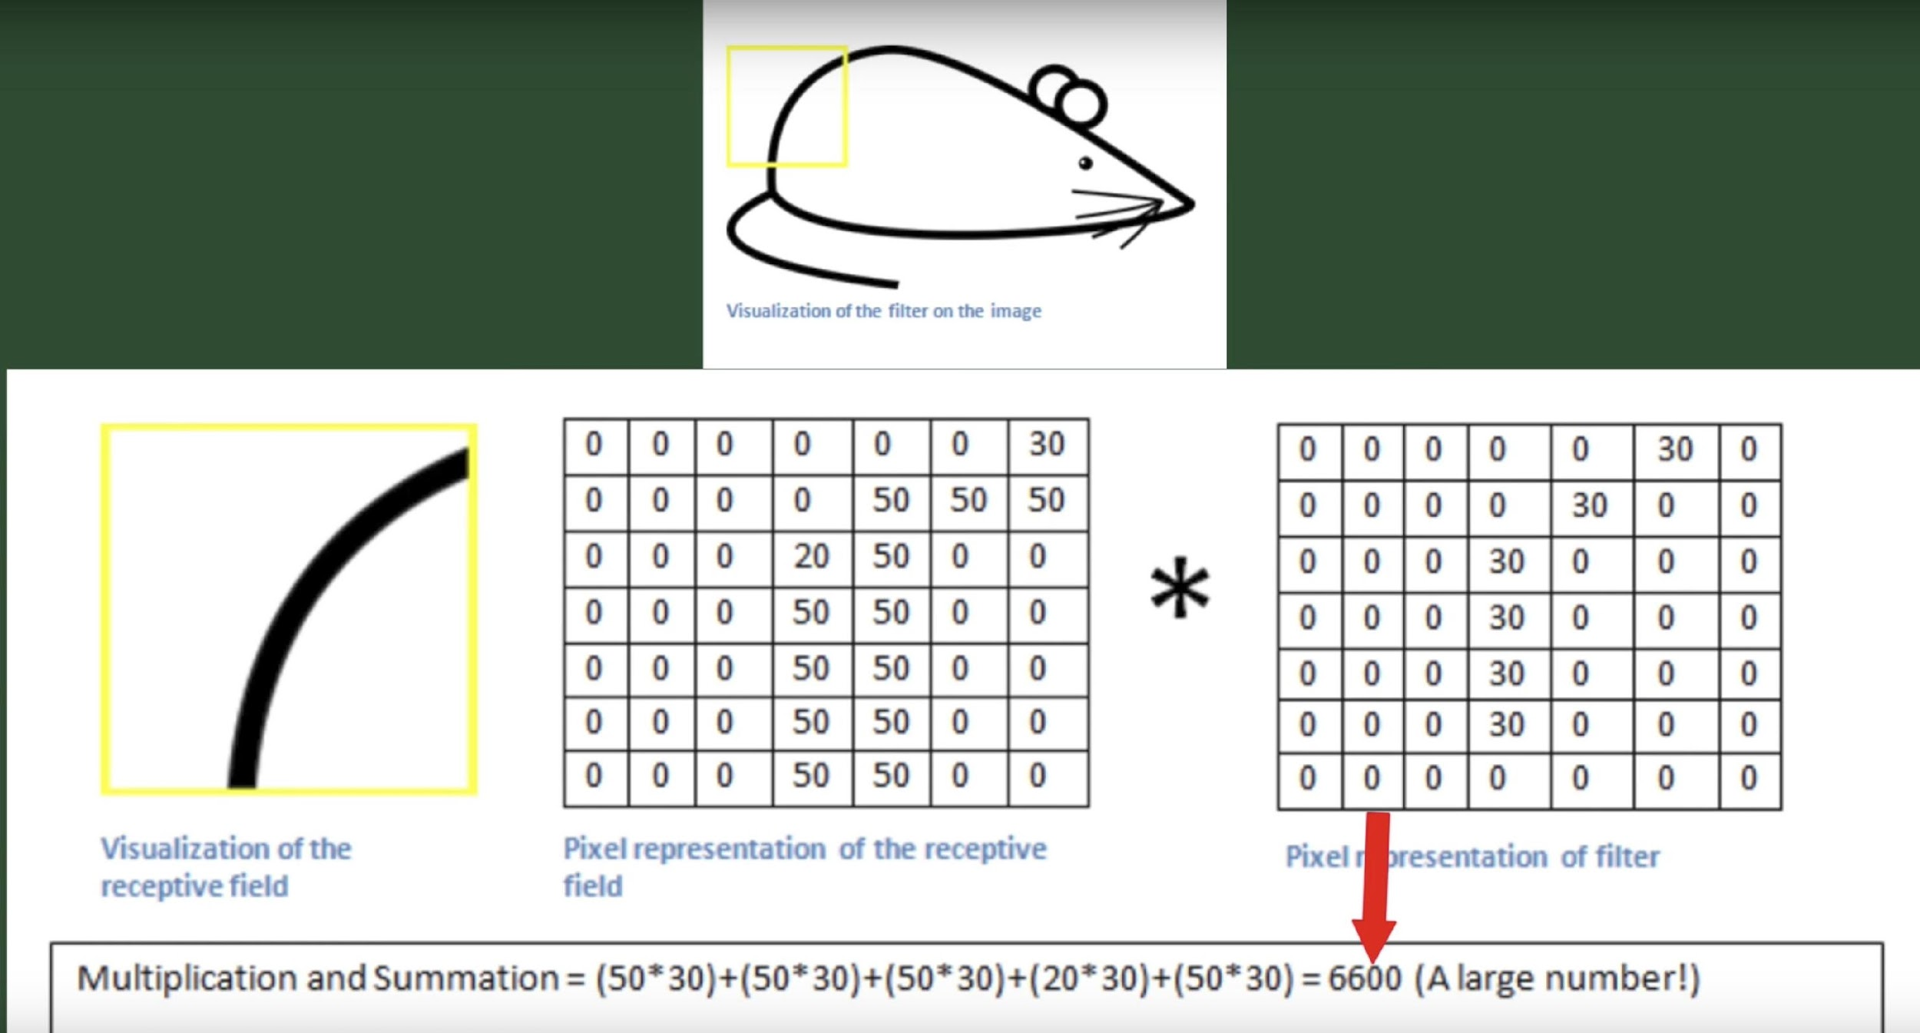
Filter/Kernel
29

